Slide 1
US Home Rental Analysis
Marcus McBride
Roopa Karajgar
Alvin Kim

Slide 2
Our project began with a simple observation: “Home rental prices are really high these days. Why?” To delve into this, we utilized the following sources: Kaggle (rental info for 17,000 American cities) Zillow (additional rental and city data) The US Census Bureau (population statistics, rental vacancy & job data)

Slide 3
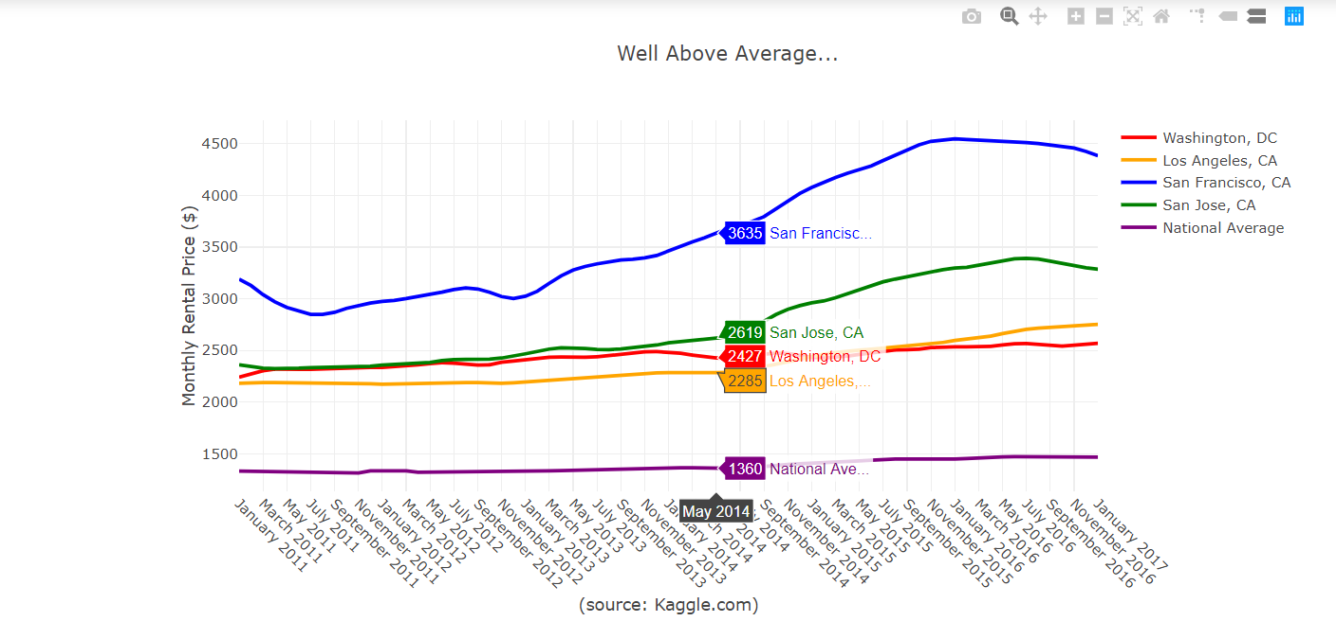
Tools utilized in this project: Python | Jupyter | Pandas/Numpy | Matplotlib | Google Maps API | Plotly.JS

Slide 4
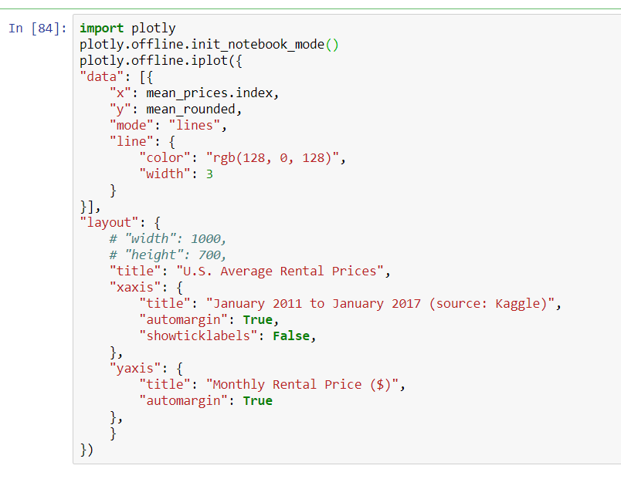
Sample Plotly code

Slide 5
For this project we looked at the available data from our sources between 2011 and 2017. We also asked ourselves a number of questions along the way: Are rental prices higher just in bigger cities or is it a nationwide? Which cities have taken off, are catching up, or have fallen behind? What factors could be causing the changes that we’ve seen? (and a lot of other questions… which we’ll come back to in a minute)

Slide 6
One Minor Data Quirk: The Kaggle data that we used is based off rental prices in cities in the United States which are ranked by “city” population, not “metro” population. When considering the following data keep in mind it refers only to each “city” population, not to the entire “metro” area. For example, Orange County is considered as part of the Los Angeles “metro” population but its rental data is broken down individually by each city. Conversely, all 5 boroughs of New York are combined together, leading to a lower average overall despite considerably higher rents in various parts of the city (Manhattan, etc).

Slide 7
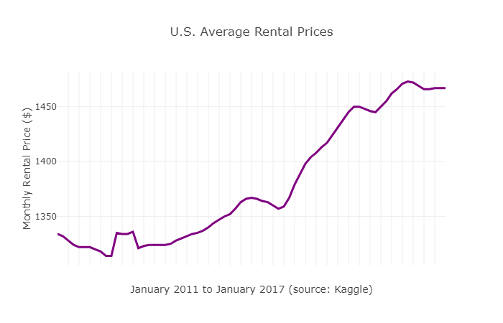
Average annual rent increase: 1.7% among the 17K cities surveyed
Let’s start with the national average.

Slide 8
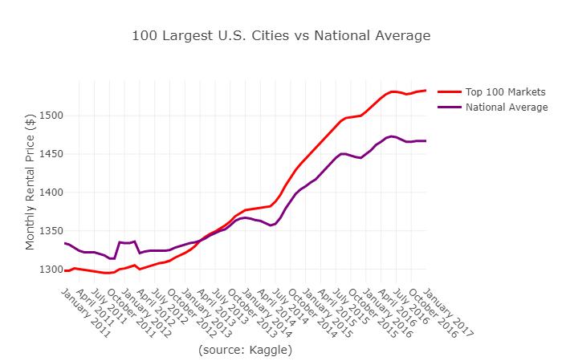
How do the 100 largest cities in the US stack up against the average nationwide?
Average annual rent increase: 3%

Slide 9
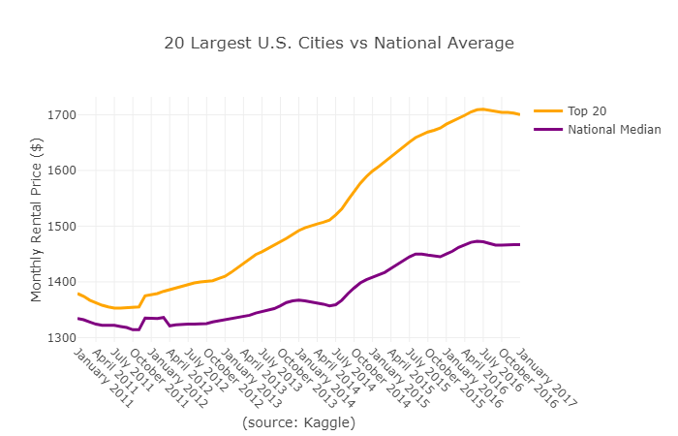
Average annual rent increase: 3.9%
How do the 20 most populous cities in the US stack up against the average nationwide?

Slide 10
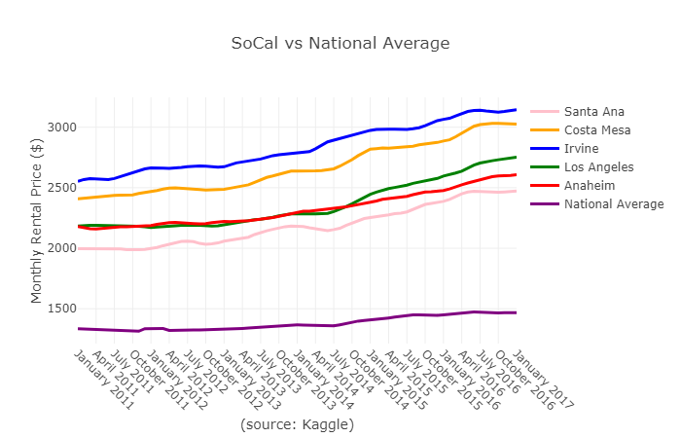
And what about Southern California?
Average annual rent increase: 4.3% (2.6% more than the national average). Newport Beach, Santa Monica & Beverly Hills are all (literally) off the chart.

Slide 11
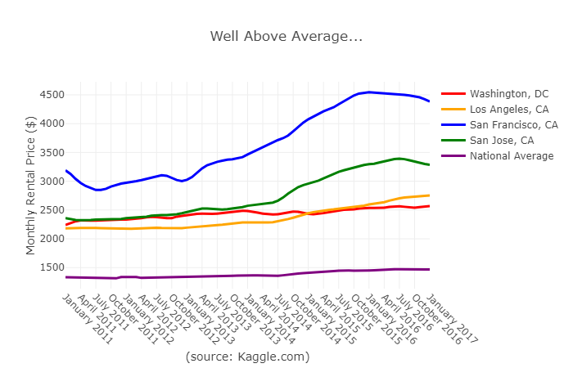
In some of the biggest of the big cities, it’s expensive.
Really expensive. San Francisco reigns supreme as the most expensive “big” city in the country to call home.

Slide 12
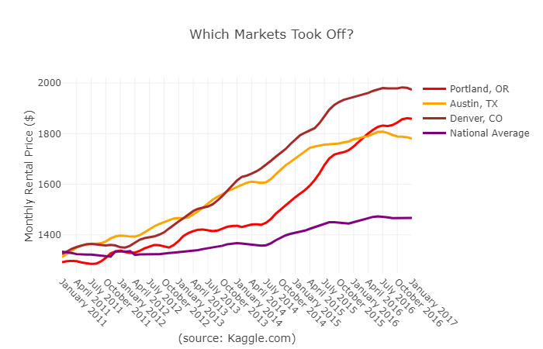
Which cities have accelerated past the national average?
Portland, Austin and Denver are the winners here.

Slide 13
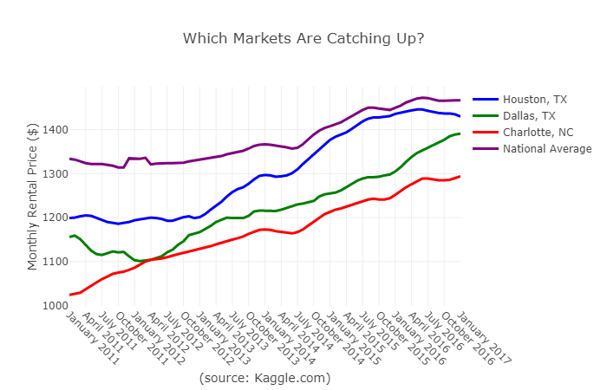
Which cities are catching up?
Look out Houston, Dallas, and Charlotte. It’s starting to get a little pricey around there.

Slide 14
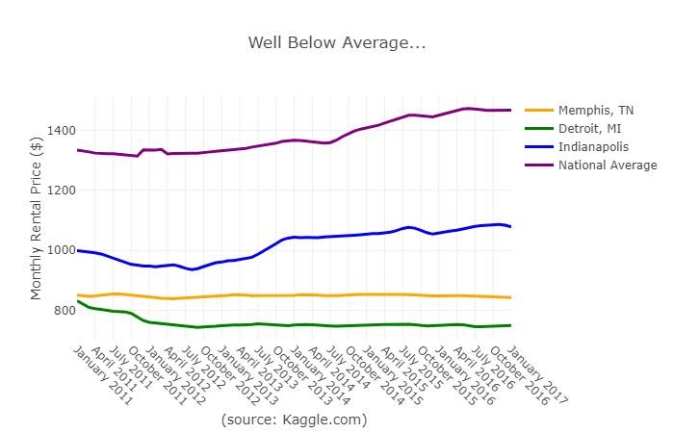
Which cities *aren’t* catching up?
Of the top 20 largest cities in the U.S., Detroit and Memphis are the only ones to have gone down. Despite being the 17th largest city, Detroit is the least expensive to live in of the top 100.

Slide 15
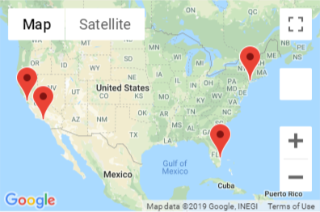
The priciest, mapped.
Atherton, CA. Malibu, CA. Rye, NY. Scarsdale, NY. Jupiter Island, FL. If you’re currently renting in any one of these, you’re paying. A lot.

Slide 16
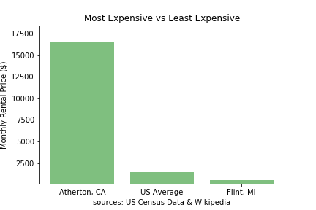
The two extremes.
Atherton, CA (pop. 7,156) is the most expensive ZIP code in the United States (1029% over the national average). At $549 a month, Flint, MI is currently the least expensive American city to rent in (62% less than the national average).

Slide 17
So…. why, exactly have prices gone up?
Our initial observation triggered a lot of questions… which in turn triggered a lot of other questions. The full answers are probably beyond the time and scope of our first group project but we did find a few insights.

Slide 18
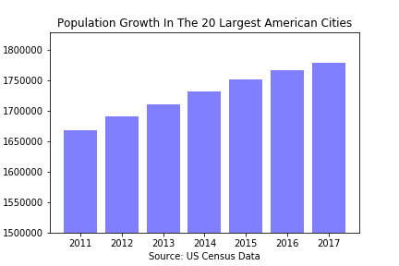
Big cities are getting bigger.
The 20 largest U.S. cities combined add about 1.5 million new residents every year over the period surveyed.

Slide 19
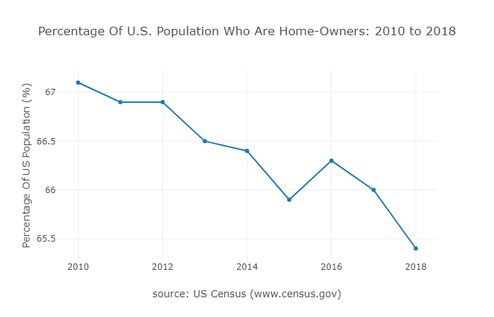
We’re buying less and (possibly) renting more.
Not by much but home-ownership in the U.S. has slowly declined over the period we had data for.

Slide 20
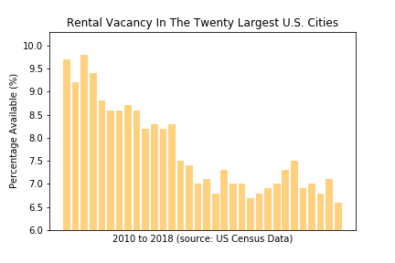
There are fewer rentals on the market.
In 2010, there was nearly a 10% rental vacancy rate among the twenty largest American cities.
It’s since dropped to a current rate of 6.6%.

Slide 21
Closing observations:
Big cities are getting bigger and more expensive but not exclusively so. (Houston, Dallas, etc).
A lot of that growth is out west. (11 of the 20 largest cities) We’re renting more with fewer choices in our biggest cities.
The data used here is a deep rabbit hole.

